Slide 1
Final Capstone Project
By: Andrew Wagner

Slide 2
1. Introduction
Scenario:
On March 17th, 2020, former New England Patriot QB Tom Brady decided to agree to a deal with the Tampa Bay Buccaneers. As a lifelong Bucs fan, this is the greatest moment in my fandom since their Super Bowl 37 victory over the Oakland Raiders. It is time to make the move to Tampa Bay to capitalize on the next 3-year dynasty in the NFL. My goal is to open a new sports bar called "Tampa Tommy’s." This is where all the die-hard Bucs fans will come to cheer on the home team in pursuit of another Super Bowl this century.
Problem:
I have not lived in Tampa, Florida since I was a 1 year old, and I have no clue where all the existing establishments are. My goal is to have a sports bar close to Raymond James Stadium so that when fans cannot afford tickets, they can still tailgate at the stadium and then come over to Tampa Tommy’s for the actual game.
Goal:
To find the perfect location for Tampa Tommy’s so that it is a thriving business before the team becomes mediocre again.

Slide 3
2. Data
The data we will be using is listed below.
We want to find the venues around Raymond James Stadium, cluster them, and determine which block is the best place to try and startup a new restaurant.
Foursquare add geopy data will be used to look up these venues.
We will then cluster the data we collect to determine which area would be the best place to start Tampa Tommy’s.
Once the cluster is determined, we will look up rental properties in the area to determine where Tampa Tommy's will be located permanently.

Slide 4
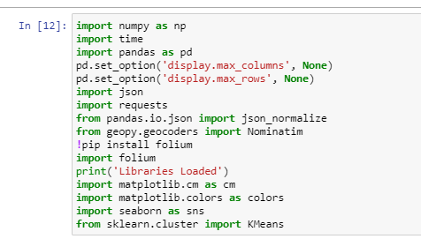
2. Data (Code)

Slide 5
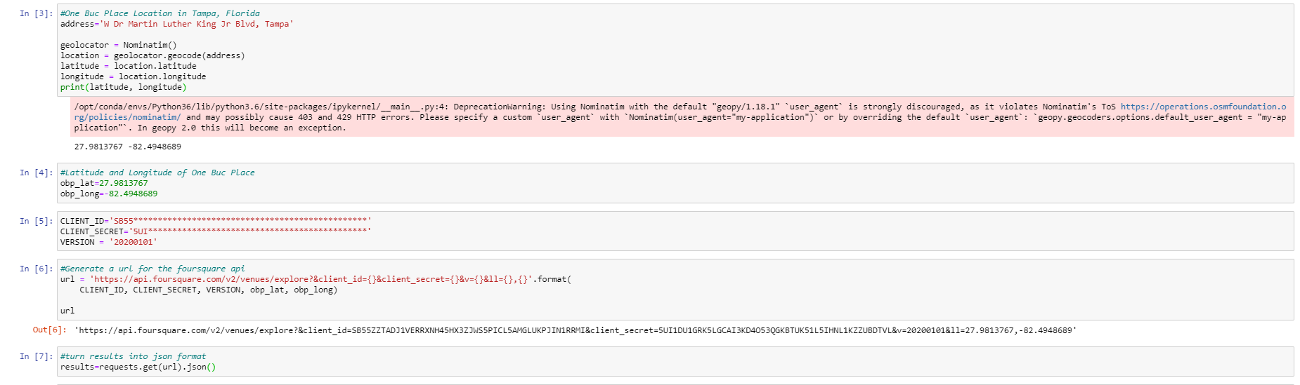
2. Data (Code)

Slide 6
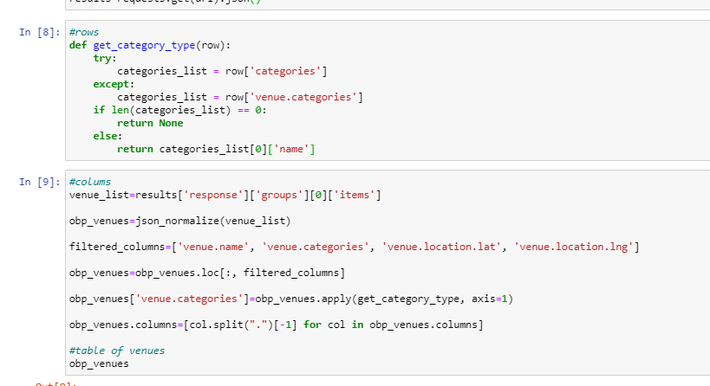
2. Data (Code)

Slide 7
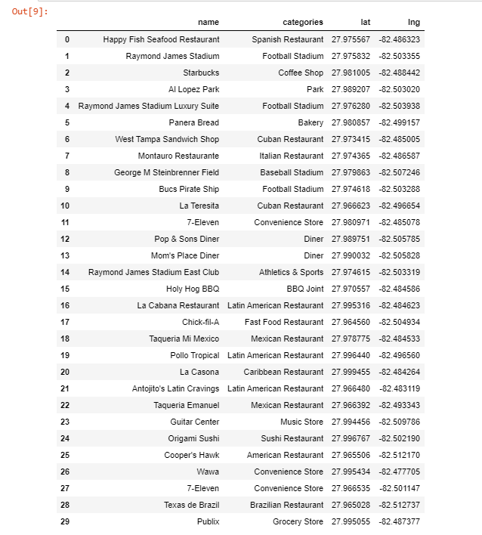
2. Data (Table)

Slide 8
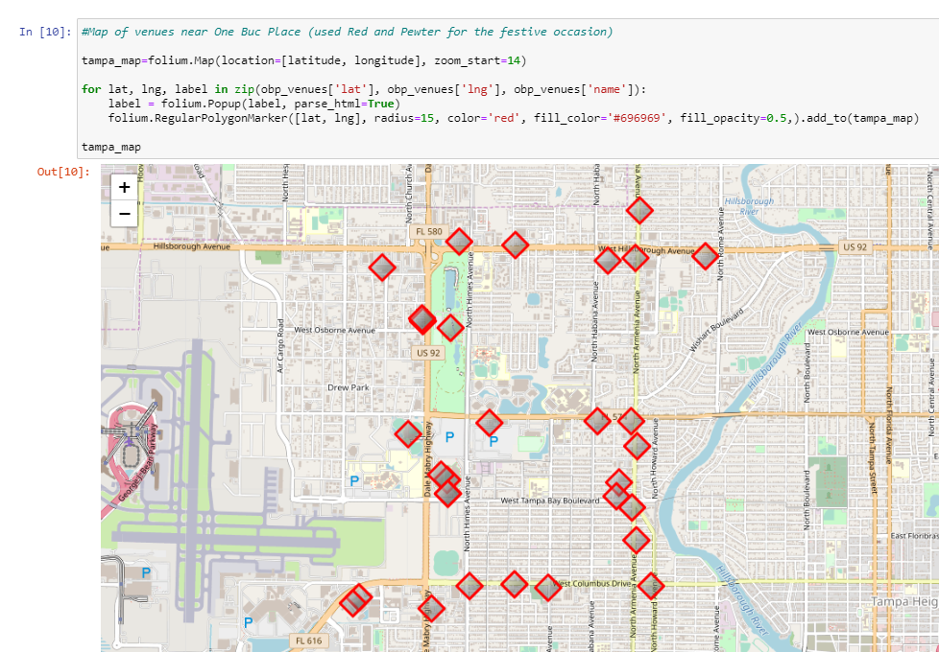
2. Data (Table)

Slide 9
3. Methodology
The goal of this section is to cluster the data collected above, and then determine which cluster area we will look for rental property for Tampa Tommy’s.
We are going to assign clusters to each of the venues we retrieved from our Foursquare API.
Cluster 1 - Restaurants that could have the capabilities of hosting gameday parties
Cluster 2 - Restaurants that could not have the capabilities of hosting gameday parties
Cluster 3 - Venues that are not restaurants
Cluster 4 - Stadiums in the area (including Raymond James Stadium)

Slide 10
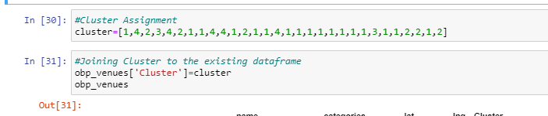
3. Methodology (Cluster Assignment)

Slide 11
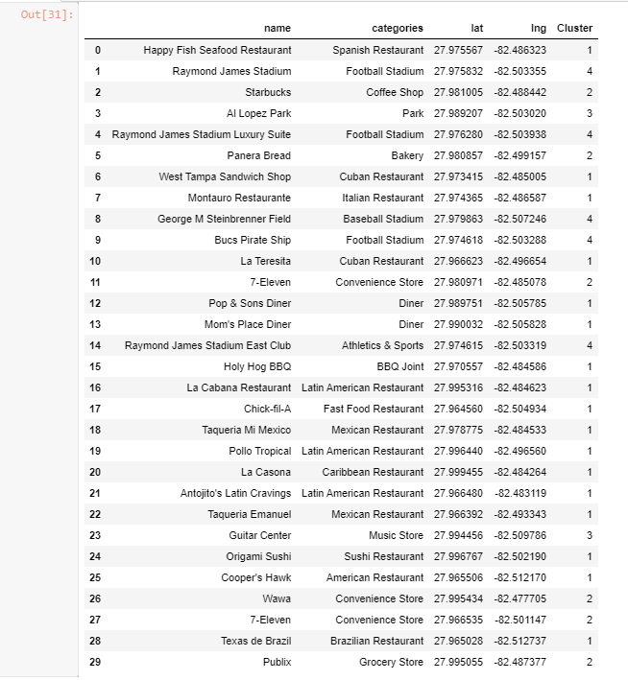
3. Methodology (Table)

Slide 12
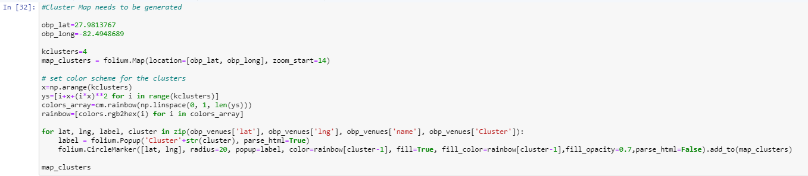
3. Methodology (Map Code)

Slide 13
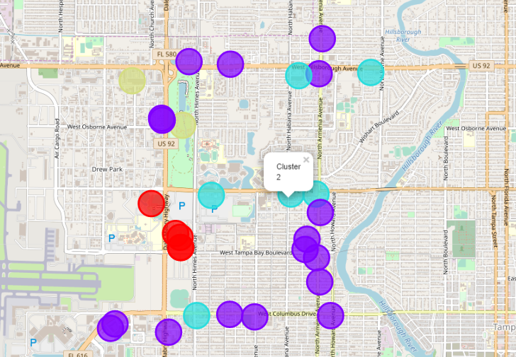
3. Methodology (Map)

Slide 14
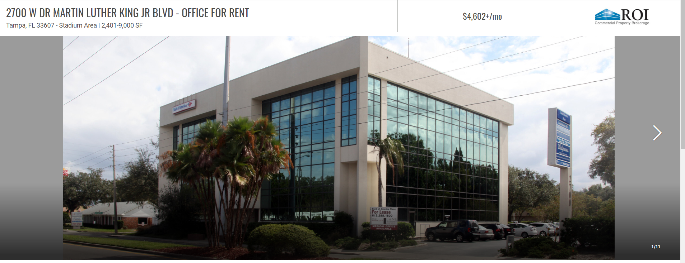
3. Methodology
This map allows us to determine which areas around Raymond James Stadium lacks restaurants capable of hosting gameday parties.
Upon further review, it looks to me that West Dr. Martin Luther King Jr. Boulevard is the area around the stadium that is lacking cluster 1 venues the most.
Based on these results, I completed a search of properties available for rent on this road to see if there are any viable options to open up Tampa Tommy's. We found that '2700 W DR MARTIN LUTHER KING JR BLVD' was available for $4,600 a month, which falls within my price range.

Slide 15
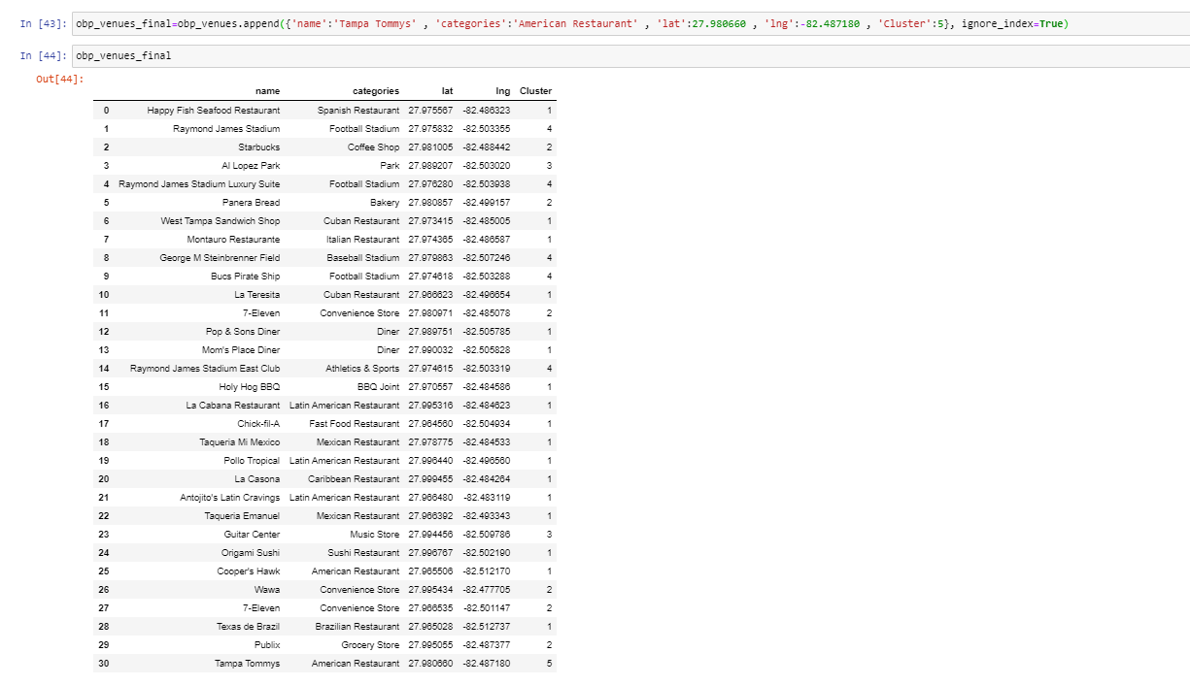
3. Methodology
We will finally add Tampa Tommy's to the cluster map

Slide 16
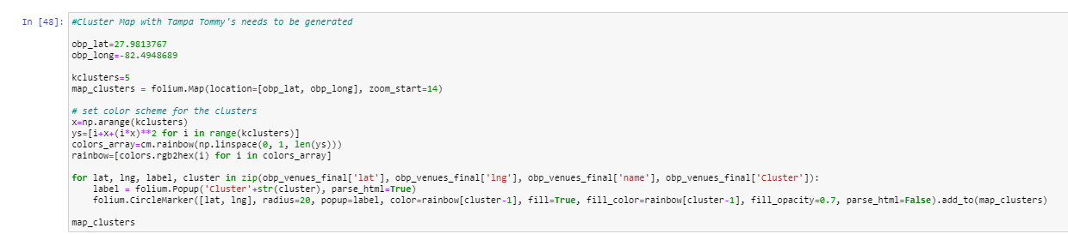
3. Methodology (Map Code)

Slide 17
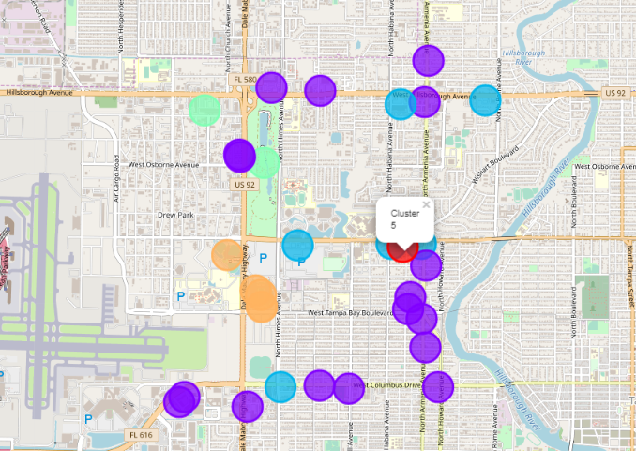
3. Methodology (Map)

Slide 18
4. Results
We found 4 different clusters based on the list we retrieved from Foursquare API
W DR MARTIN LUTHER KING JR BLVD was determined to be the best place to open up Tampa Tommy's due to the lack of restaurants currently open on this street, which is located near Raymond James Stadium
There were not many options available for rent online, but we ended up going with a property located at 2700 W DR MARTIN LUTHER KING JR BLVD
A final map with Tampa Tommy's (Cluster 5 in red) was generated

Slide 19
5. Discussion
Transportation
Unfortunately, there were not any properties located near the stadium to rent, so once this business is up and running, we will have to provide a shuttle service from the tailgating lots to the restaurant. This will allow us to get rowdy fans into Tampa Tommy's to rake up the alcohol earnings for gamedays.
Lack of Bars Near Raymond James Stadium
The biggest surprise to me while conducting this research was the lack of american bars in the area. Of the 30 results we got from Foursquare, only 1 returned in the category "American Restaurant." Fans not having a spot to go and watch the game after they are done tailgating strikes me as a major issue and an open opportunity for someone to make a good business decision.
Alternate Strategy for Next Time
If I were to do this study again, I would most likely expand my search to a wider radius and see if different parts of the city are better suited for an establishment like this. We could expand the search to all of the city districts and not just around the stadium.

Slide 20
6. Conclusion
To conclude, the choice to start Tampa Tommy's at 2700 W DR MARTIN LUTHER KING JR BLVD came down to 3 things:
Lack of restaurant options in the area
Lack of available rental properties in the area
Location was near the stadium
Let's Go Bucs!!!!!

Slide 21
Code Link:
To look at the code, follow this link:
https://dataplatform.cloud.ibm.com/analytics/notebooks/v2/32e68c1f-9fe4-40b1-8848-f3b7e50e99a5/view?access_token=1ae89d8f8313868a40c212e532d32caffaf1974527541ff0f6602ed065eb7ef0

